Slide 1

New Product Profitability Report
Kyle Gardner
Blackwell Electronics

Slide 2
Purpose
Predict the profitability of new products for Blackwell product mix
Rank top five new products from highest to lowest by profit
Identify which attributes are associated with successful products (high sale volume)
Compare, contrast, and select the optimized model for analysis

Slide 3
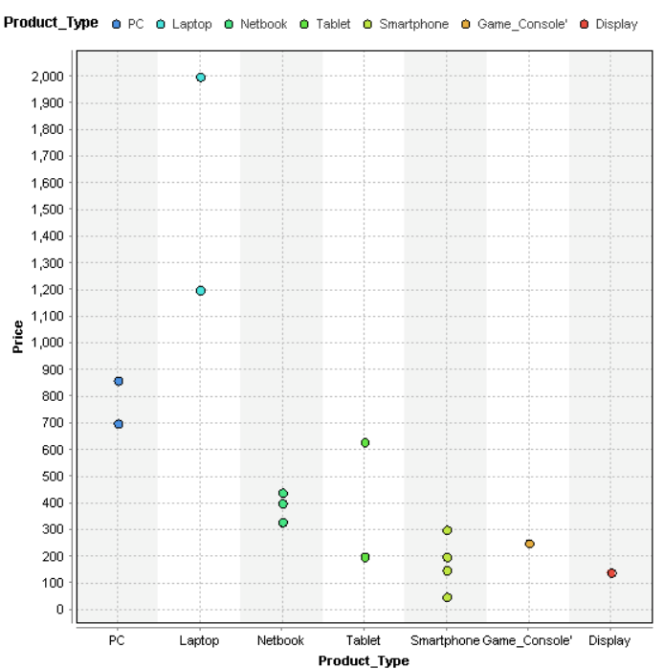
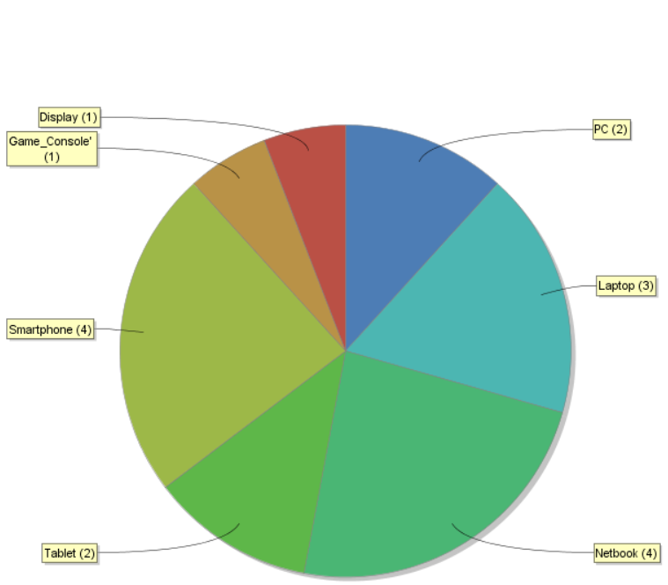
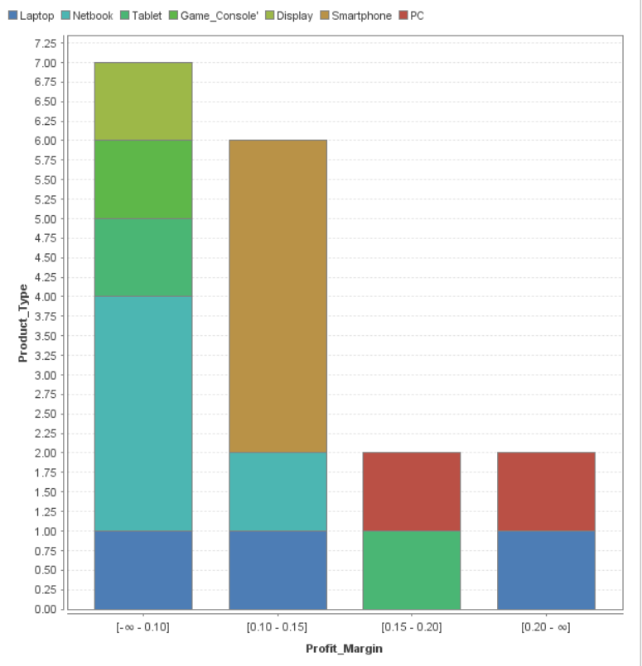
-17 new products being considered for Blackwell product mix -23% are smartphone -Highest price Laptops ($1,200-$2,000) - Highest profit margins PC ( >0.15)
New Products

Slide 4
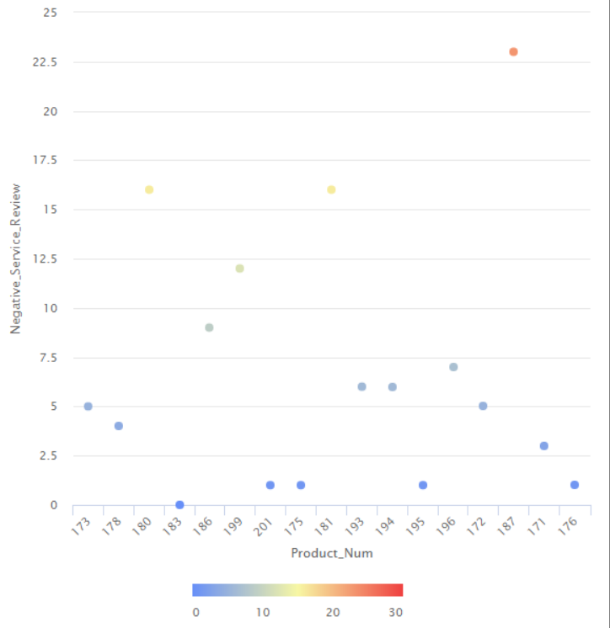
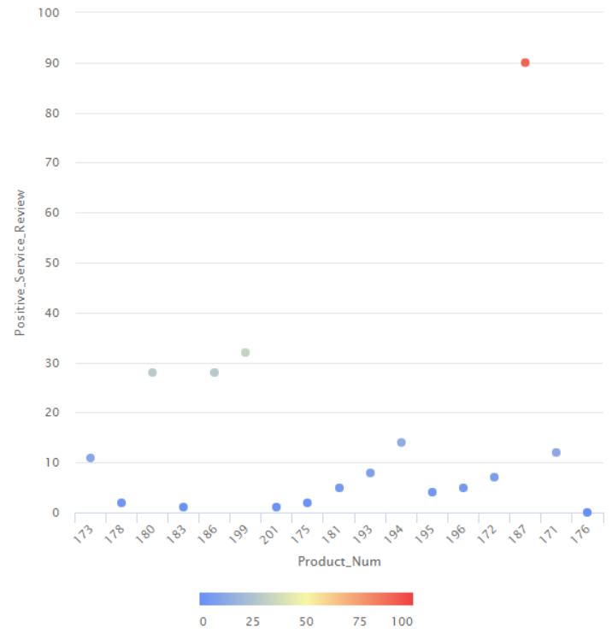
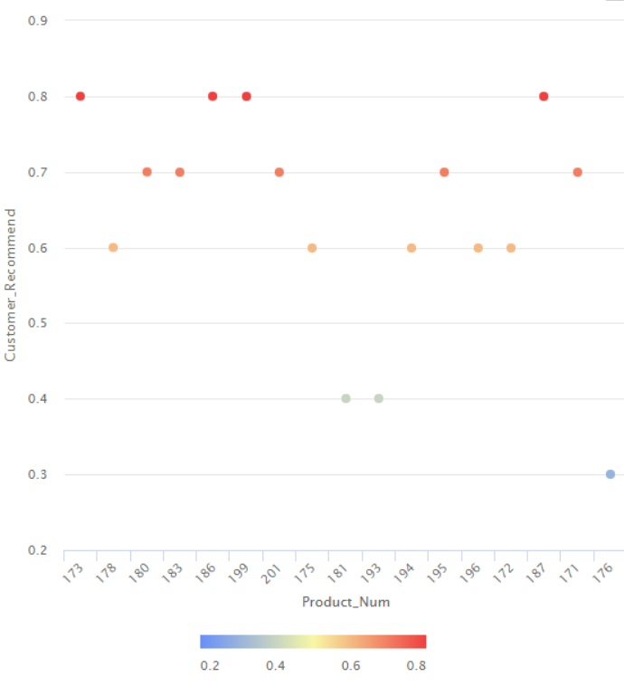
New Products Reviews
Customer Recommendation by Product #
Negative Reviews by Product #
Positive Reviews by Product #

Slide 5
Process
-Historical sale product data
to estimate the sale volume
-Identified attributes shared
by products that correlate w/
sale volume
-Machine Learning to train
and test optimal models for
analysis
-Ranked and selected the top 5
new products by predicted
profitability
h
Historical Data
Clean
Preprocessing
Feature Selection/Engineering
Removing Attributes
Predict Sale Volume
Calculated Profit
New Products
Top profitable products
Correlation Matrix
Modeling/
Optimization
Regression Models
Cross Validation
RMSE
Partition Dataset
Sample
Squared Correlation
Test

Slide 6
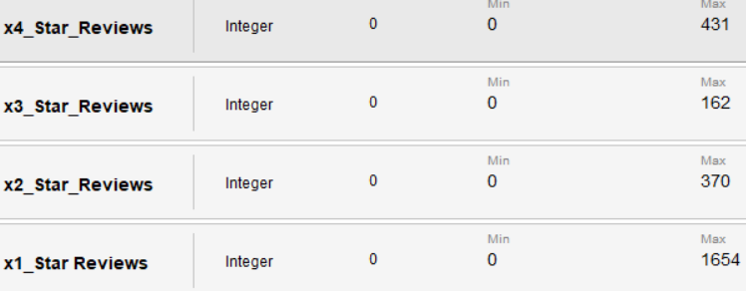
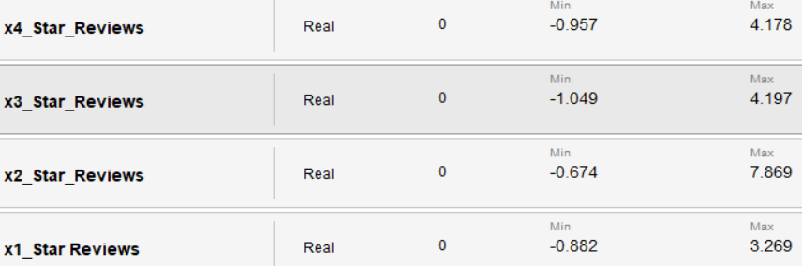
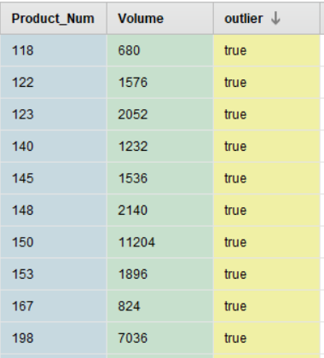
Pre-Processing and Cleaning
G.I.G.O
Checked attributes values for errors and missing data
Applied Normalization (IQR)
(Suppress wide variation in attribute values)
Outliers
Outlier Detection (Distance)
Top 10 were removed

Slide 7
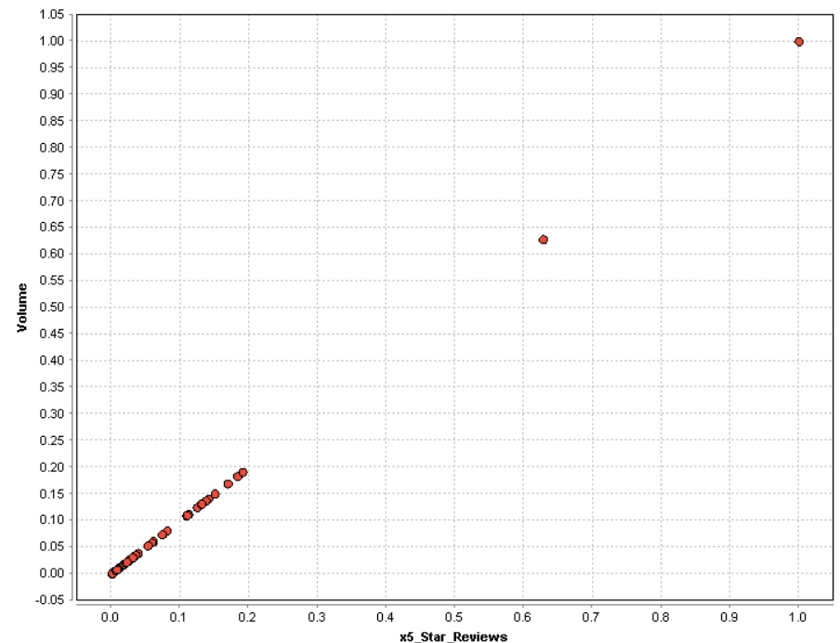
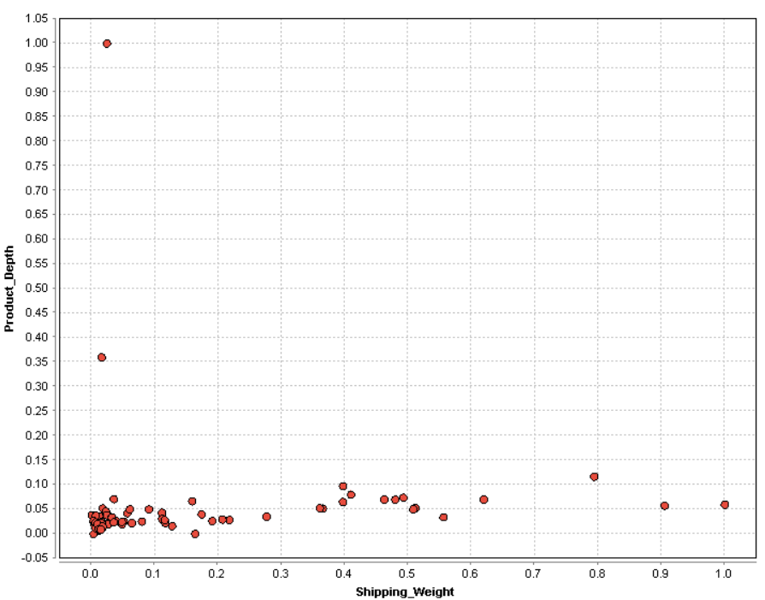
Feature Selection and Engineering
Certain attributes, of current products, maybe associated with high sale volumes
New products sharing these attributes may also prove to be profitable
Data Analysis can identify which attributes are correlated w/ sale volume and which one may not be useful for analysis

Slide 8
Modeling Optimization
Machine Learning
Modeling
Regression Model (Prediction)
Dependent variable is numerical
Trained several models (cross validation)
Optimization
Assessed performance ( RMSE & R² )
Selected best model for prediction (volume)
Applied best model to untested partitioned dataset
Algorithms: Performance Measures
KNN
RMSE: 795.917
GBT
RMSE: 800.027
SVM
RMSE: 159.927
R-Squared: 0.865
R-Squared: 0.878
R-Squared: 0.735
Parameters
C= 18.0
Convergence epsilon= 0.00011
Cross Validation folds= 37

Slide 9
New Products Profitability
17 New Products for Blackwell product mix
PC, Laptop, netbook, smartphone, game, monitor, & tablet
Profitability= Sales Volume* Price* Profit Margin
Top 5 new products ranked by highest profit

Slide 10
Review
Process
Historical sales data used to predict the profitability of new products (correlation of attributes to sales volume)
Machine learning for regression (SVM) was tested & proved to be the best model for predicting sales volume
Identified
Results
The 5 top selling products were Products # 176, 171, 175, 172, and 173 were found to be the most profitable new products.
General statistics:
 | Min. | Max | Mean
Price | $699.00 | $1,999.00 | $1,191.20
Profit Margin | 0.1 | 0.25 | 0.19
Sales Volume | $190.56 | $239.66 | $212.58
Profit | $28,735.09 | $87,612.72 | $45,472.38

Slide 11
Recommendations
Blackwell should marker the following products for their new product mix: Razer Laptop, Apple Tablet, Dell PC, Toshiba Laptop, and Apple Laptop
These products received 4 star reviews and were highly recommended from customers
The other 12 products will not be as profitable and resources allocated to these products should be put on hold. found to be the most profitable new

Slide 12
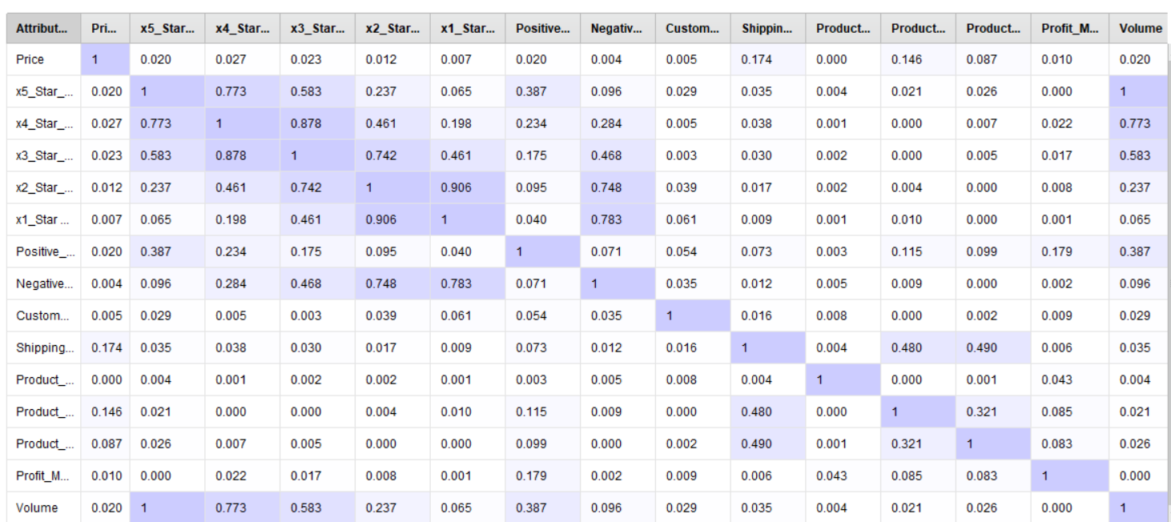
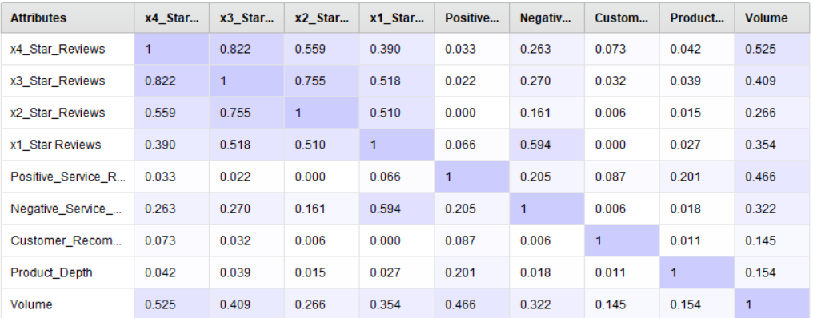
Process
Correlation
There are several attributes correlated with sale volume
(Star reviews, positive, & negative)
As star review increases so does sale volume (0 to 1)
Relationship is positive and strong
Attributes with correlations values near 0 were removed
Key Findings
Recommendations

Slide 13
New Product (NP) Profitability
Rank | Product No. | Product Type | Brand Name | Predicted Profit
1 | 176 | Laptop | Razer | $87,612.72
2 | 171 | PC | Dell | $38,933.02
3 | 175 | Laptop | Toshiba | $36,181.33
4 | 172 | PC | Dell | $35,899.74
5 | 173 | Laptop | Apple | $28,735.09
6 | 187 | Tablet | Amazon | $22,649.00
7 | 186 | Tablet | Apple | $18,501.33
8 | 181 | Netbook | Asus | $11,922.75
9 | 180 | Netbook | Acer | $9,326.45
10 | 196 | Smartphone | Motorola | $8,234.11
11 | 178 | Netbook | HP | $7,137.38
12 | 199 | Game Console | Sony | $7,127.51
13 | 183 | Netbook | Samsung | $6,476.12
14 | 193 | Smartphone | Motorola | $5,456.68
15 | 195 | Smartphone | HTC | $5,237.85
16 | 194 | Smartphone | Samsung | $1,563.96
17 | 201 | Monitor | Asus | $1,445.99
Highly Profitable
Predicted Profitability = Predicted Sales Volume_OP X Price_NP X Profit Margin_NP
Key Findings:
Highly profitable: Laptop and PC
Price Range: $699-$1,990
4 star rating
Razor laptop at leastt2.5 X > other products
Recommendations:
Kuy
ffefgfhgff
Moderately Profitable
Least Profitable

Slide 14
Viability of Blackwell Electronics
To sustain & expand Blackwell Electronics’ influence in the market, we must improve our understanding of customers and products
Data team utilized data mining to provide insight on how to tackle this emerging obstacle and increase profit
Customer Buying Patterns
Customer Profile
Difference in sales to due : region, age, and transaction type
New Product Profitability
Predictive Analysis
Forecast product success from attributes of old products: importance, relationship, and prior sales

Slide 15
Actions to be taken
Customer Buying Patterns
New Product Profitability
Identified differences in customer preferences
Central $$$$ vs West $
80% of central were < 51yr vs 60% of west >52 yr
<35 yr tend to shop In-store vs >51yr prefer online
Utilization of data mining
There is significant correlation for age & amount spent; also region & transaction type
There was no correlation for items & amount spent
Action steps
Conduct S.W.O.T analysis to assess demographic/region sales differences
Implement strategic marketing campaign to boost sales in west
Investigate products selection among < 35 yrs vs >52 yr
Predicted profitability
PC & Laptops are highly profitable
Price range:$699-$1,990
Profit Margin Average: 0.19
Utilization of data mining
Identified attributes of products correlated w/ high sales volume
Ranked and narrowed down top 5 products for Blackwell’s line
Action steps
Products w/ low or moderate profit should not be considered for new product line
Consider partnering w/ top company to add accessories for PC & Laptop to product line

